Slide 1
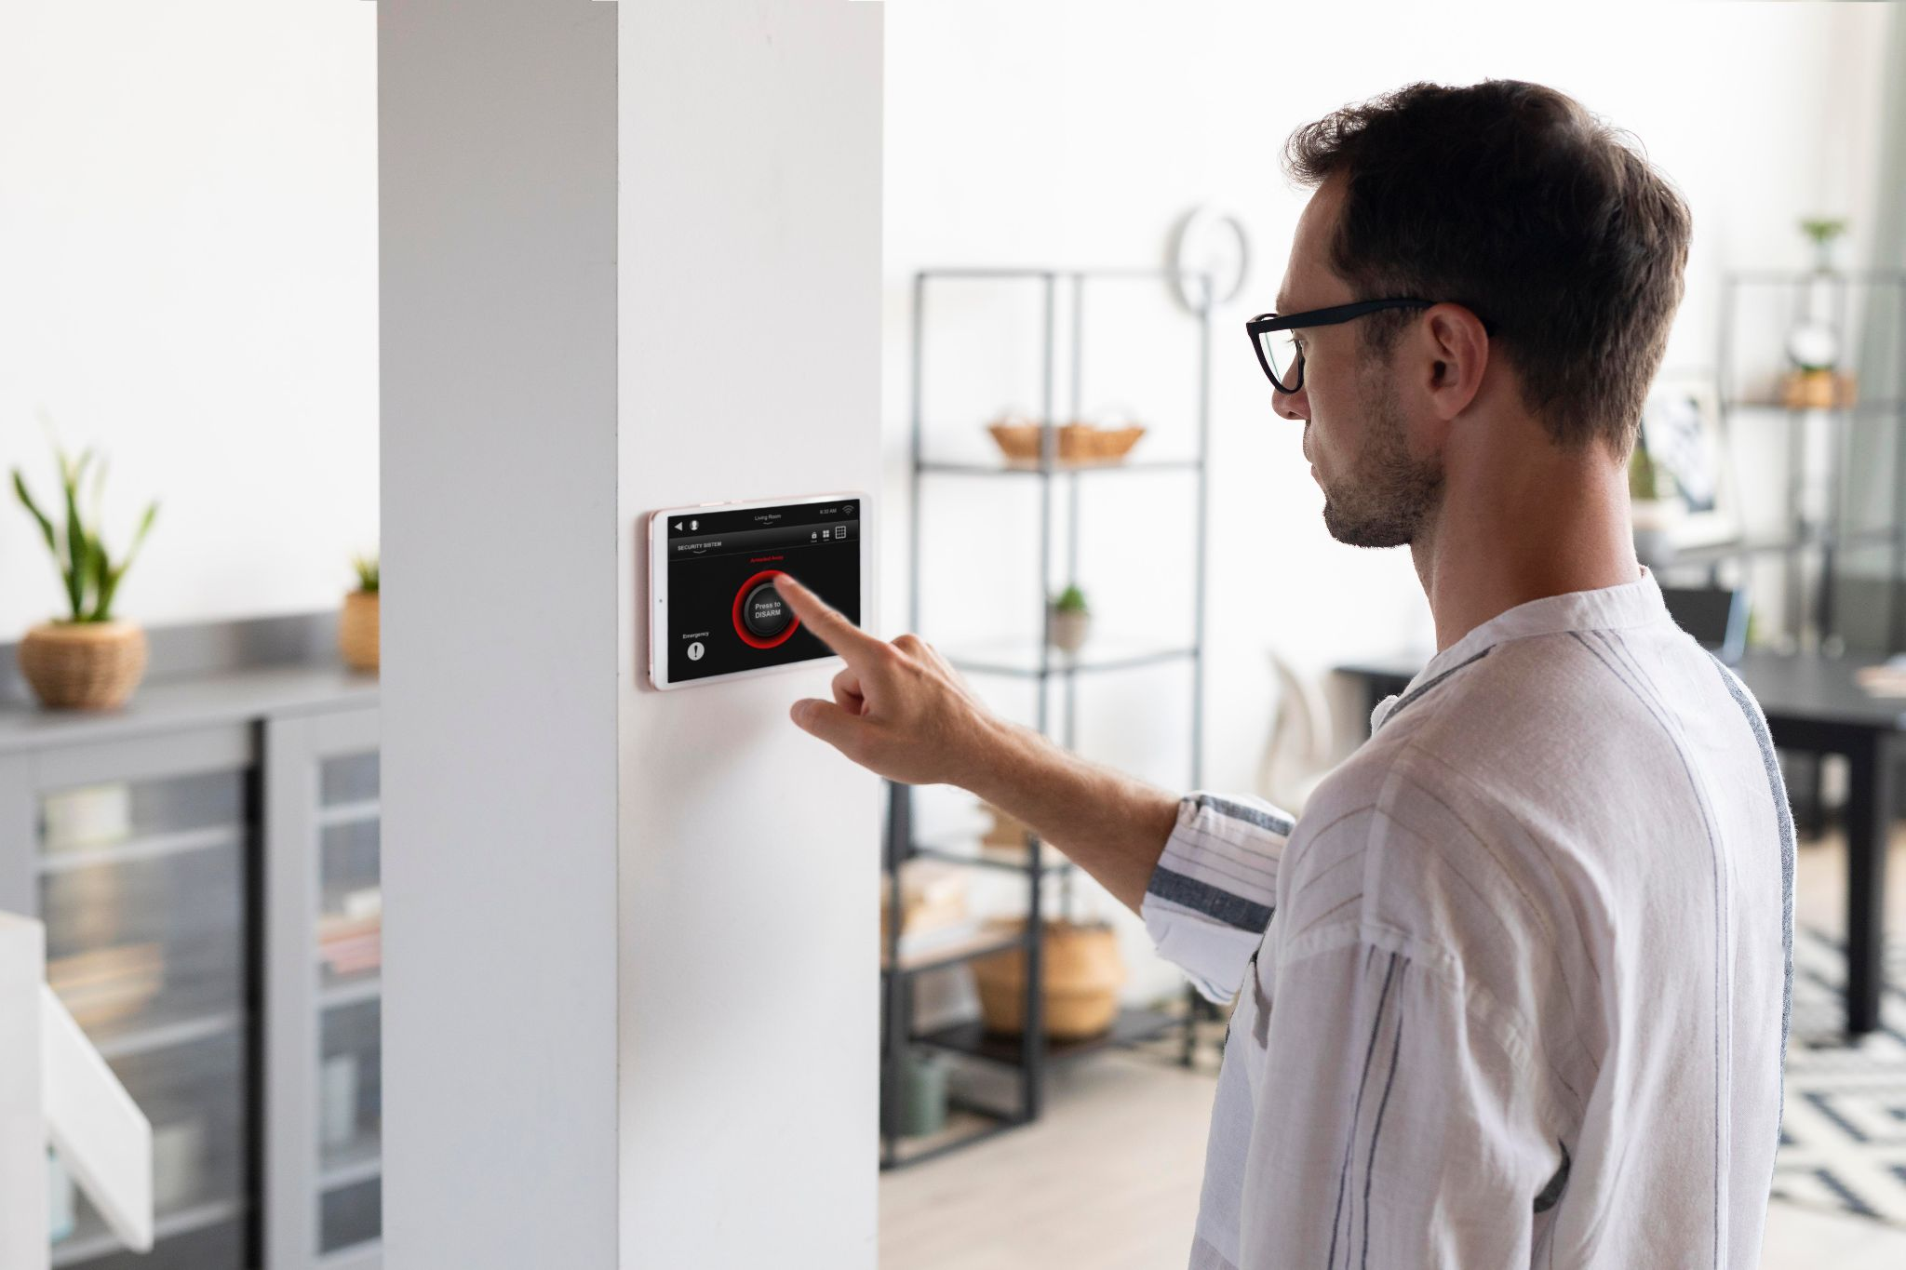

SMART HOME PROJECT
Tomer Zamir

Slide 2
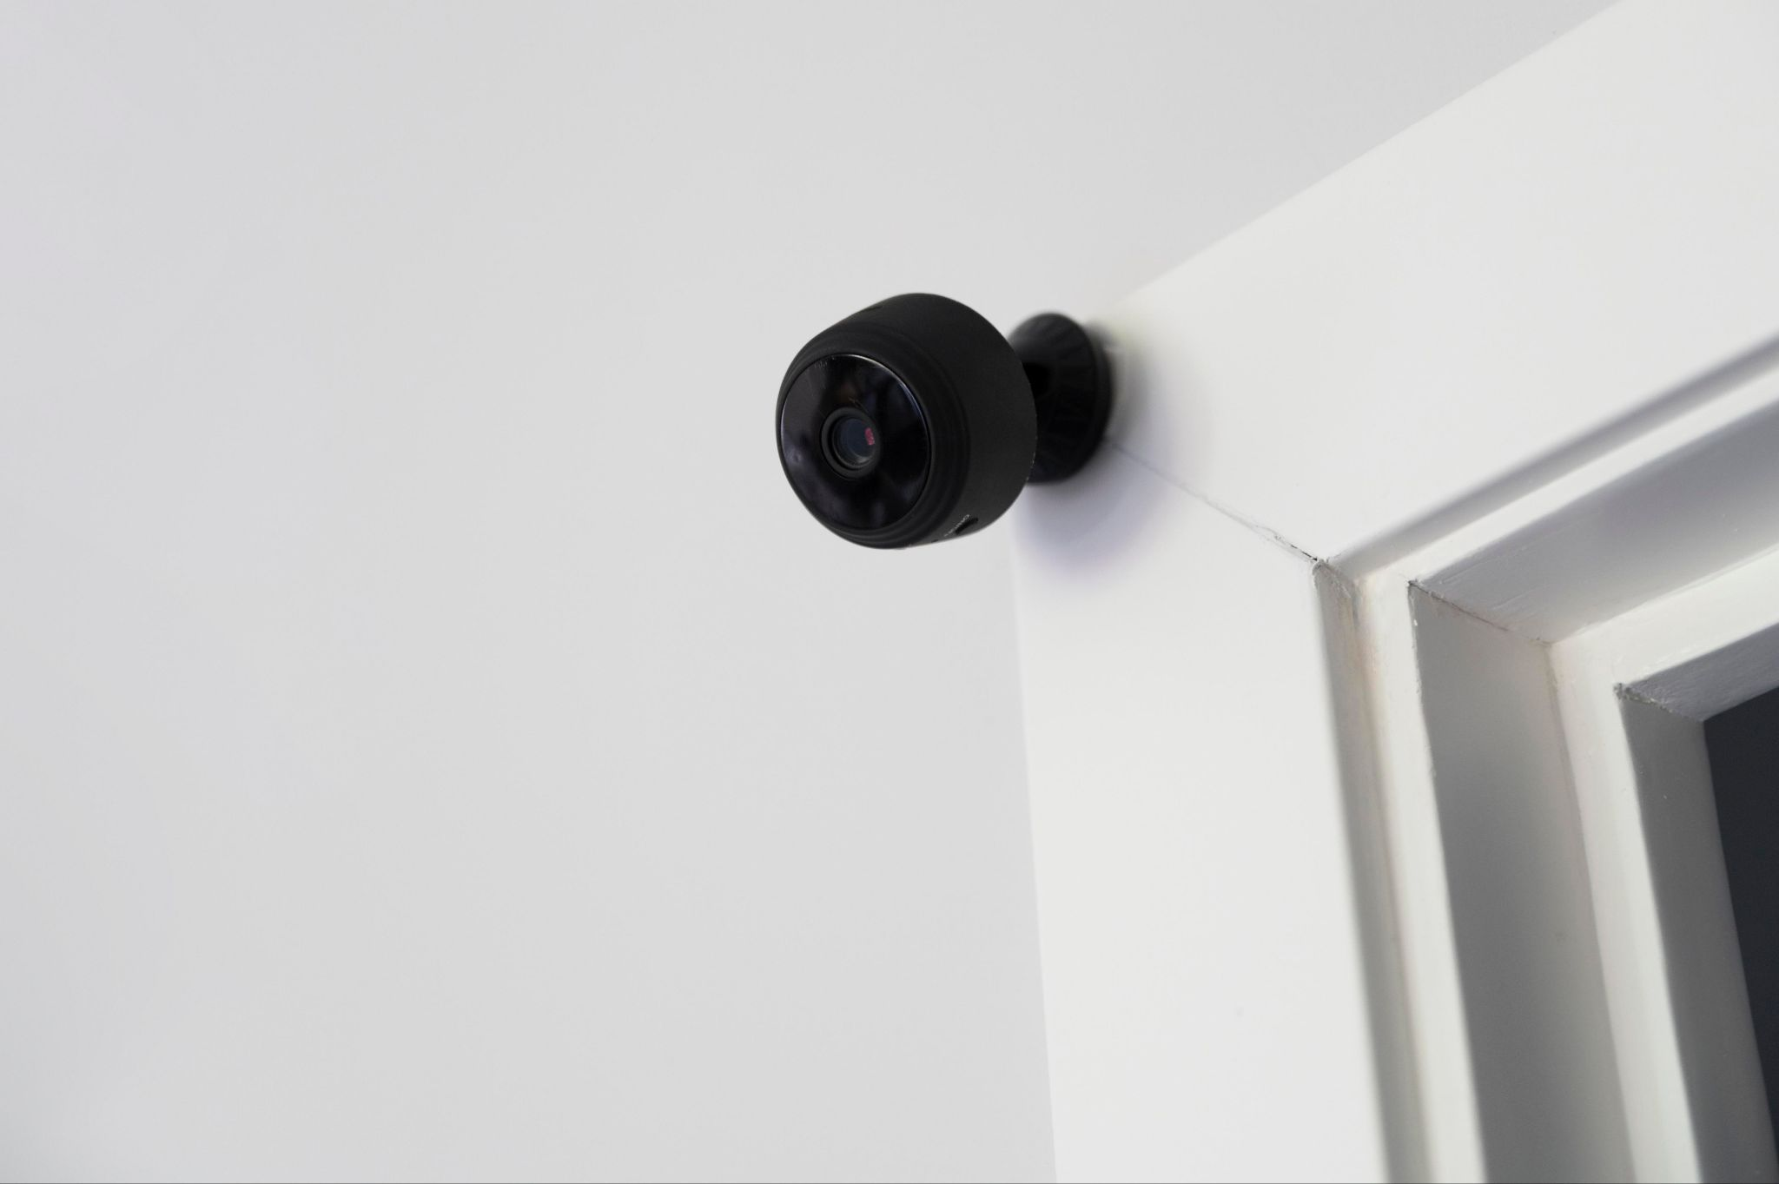
IoT
The Internet of Things is a network of physical objects that are connected to the internet and can collect and exchange data. IoT has the potential to revolutionize many aspects of our lives, from the way we live and work to the way we interact with the world around us.

Slide 3
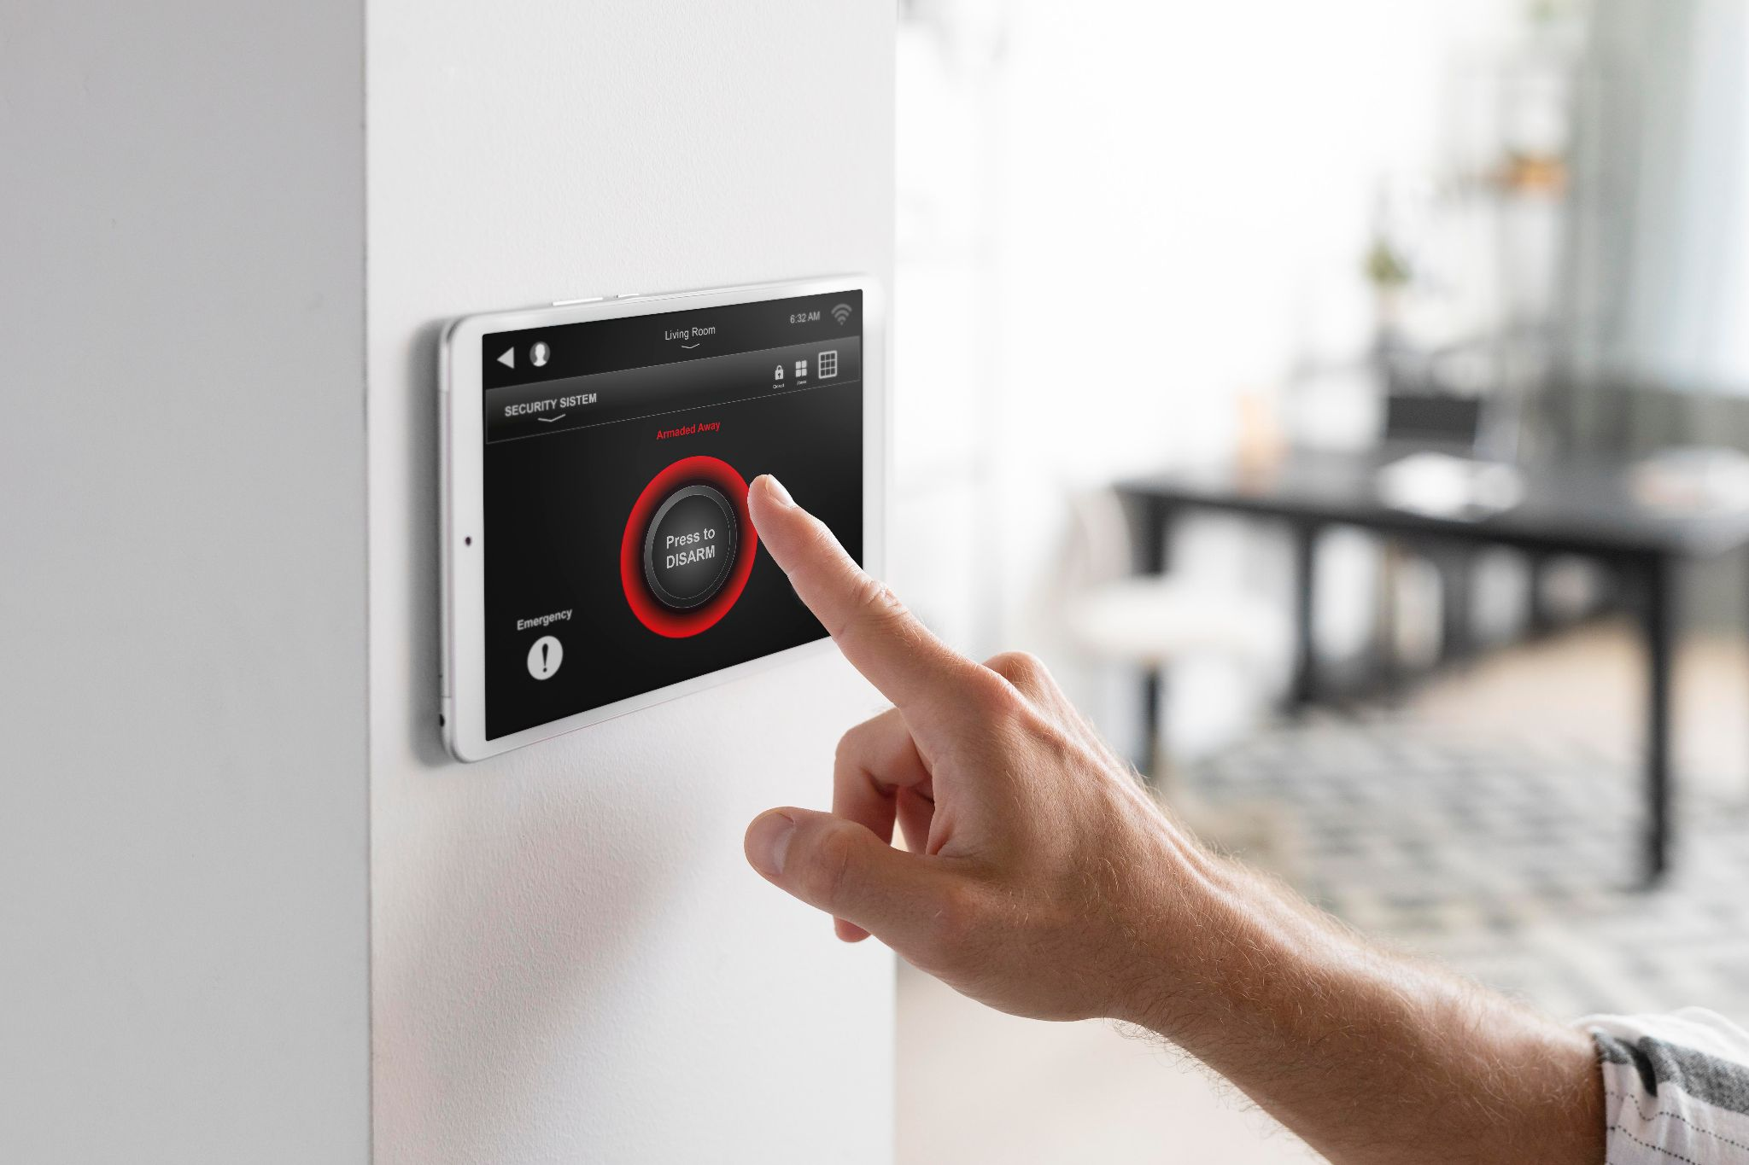
Smart Home
IoT devices can be used to control and automate many aspects of our homes, such as lighting, thermostats, and security systems. This can make our homes more comfortable, energy-efficient, and secure.

Slide 4
Targets
Emulators
01
Data Manager App
DB
02
04
GUI
03
Developments of emulators of smart home devices
An Application for the system that controls the IoT device
Collecting data from broker and writing it to local DB
Integrating a local Data-Base

Slide 5
Functional Requirements
01
02
04
The app will display current temp for all rooms
users will be able to control AC settings
03
users will be able to turn on/off the boiler
users will be able to control fridge settings
05
The app will display ‘consumption timeline’ graph
06
The app will display door status – open/closed

Slide 6
Non-Functional Requirements
01
02
04
The code will be written in Python
The app will support English only
03
The app will be lightweight: <1MB
The broker used will be MQTT
05
The GUI will be based on PyQt5

Slide 7


Use Cases
Water Meter
Electricity Meter
AC
Fridge
Monitor water consumption
Monitor electricity consumption
Monitor home temp and control air-conditioner
Monitor and control your freezer

Slide 8


Use Cases
WIFI
Security
Monitor internet connectivity
Know if you left the door open

Slide 9
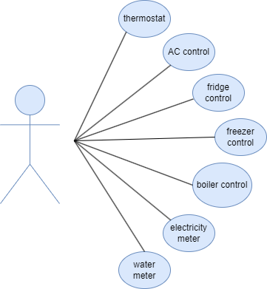
Use Cases

Slide 10

HOW IS IT DISTRIBUTED?
Smart Fridge
Smart Boiler
Secure door
Smart AC

Slide 11
Design and Implementation
MQTT
01
02
03
IoT device
System App
Broker: an intermediary entity that enables communication
[Emulators] collect sensory data And send to broker
Recives data from broker. Sends back requests (directed by the user) to the connected devices via the broker.

Slide 12
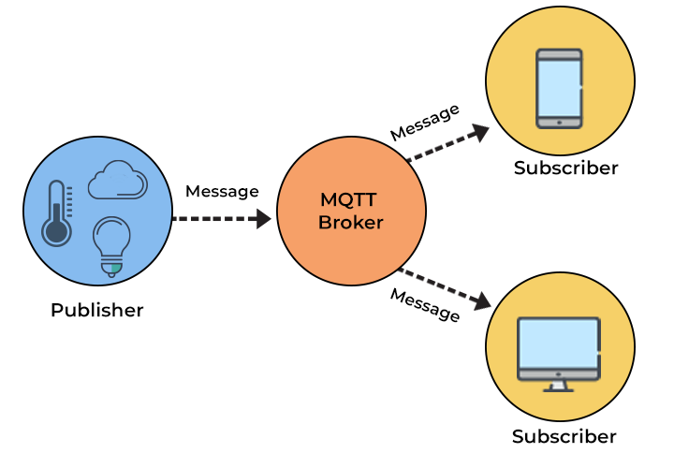
Design and Implementation

Slide 13
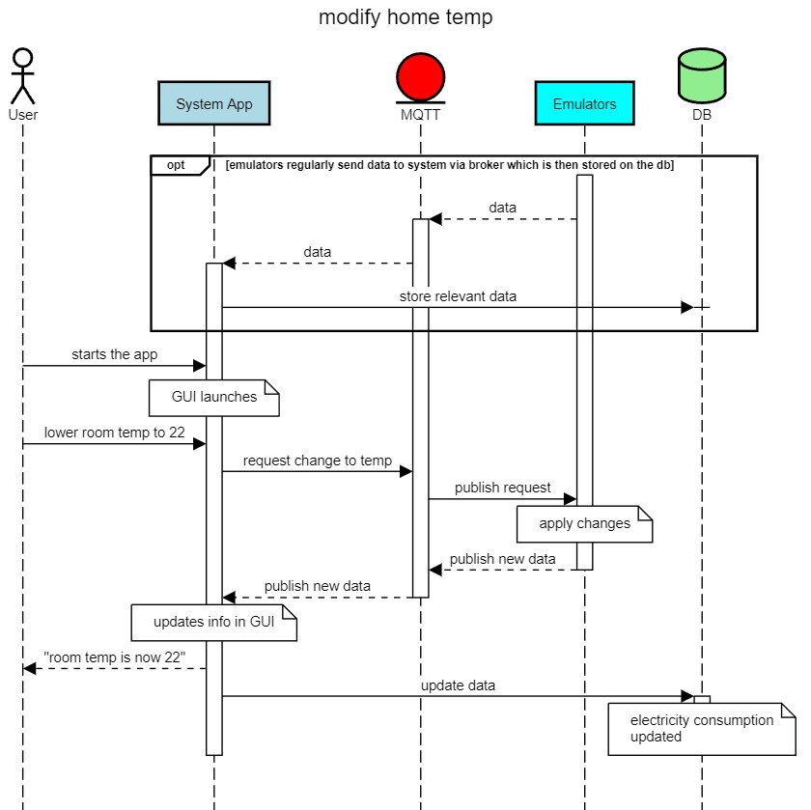

Slide 14
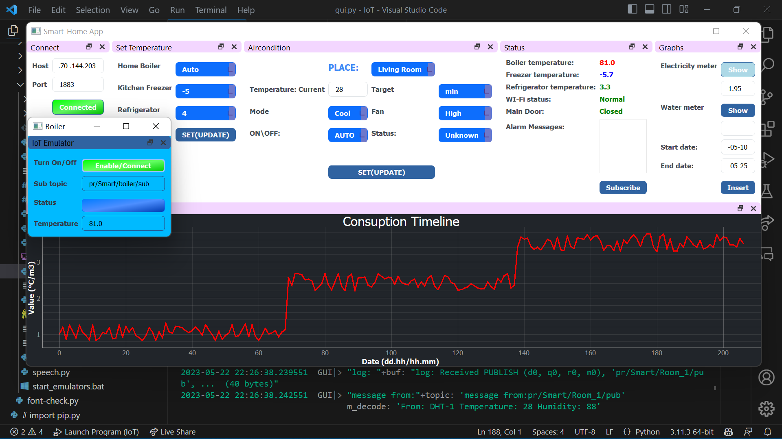
SNEAK PEEK

Slide 15




